Slide 1

Multi-Threaded Chat Server and Client
Adarsh Kumar
24NAG1279_U03

Slide 2
Introduction
The project involves developing a chat server and client application in Linux using C.
Key features include user authentication, message formatting with timestamps and server logging.
The system supports multiple clients simultaneously.

Slide 3
Project Objectives
Develop a robust chat server and client in C.
Implement user authentication for secure communication.
Allow clients to send and receive broadcast and private messages.
Format messages with timestamps for better readability.
Log user actions on the server for monitoring and debugging.

Slide 4
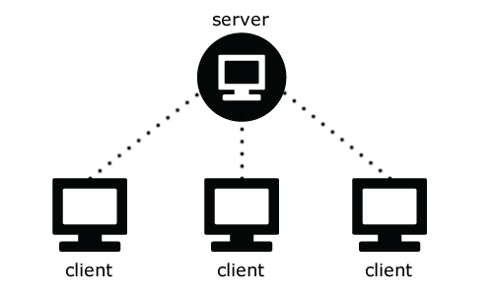
System Design
Server
log_message()
get_timestamp()
handle_client()
broadcast_message()
send_message()
Chat Server
log_message()
get_timestamp()
handle_client()
broadcast_message()
send_message()
Chat Client
receive_message()
Client
recieve_message()
Client
receive_message()
Client
receive_message()
Client
receive_message()

Slide 5
Chat Server Overview
Handles multiple client connections using threads.
Authenticates users and assigns usernames.
Formats and broadcasts messages with timestamps.
Logs user actions.

Slide 6
Chat Client Overview
Connects to the server and handles user input.
Sends messages to the server.
Displays messages received from the server.
Supports private messaging.

Slide 7
User authentication
Users are prompted to enter a username upon connecting.
Usernames are used to identify clients.
Ensures secure and personalized communication.

Slide 8
Message Formatting with Timestamps
Messages are formatted with timestamps before broadcasting.
Example: [2024-08-07 12:00:05] user1: Hello everyone!
Helps users track the timing of messages.

Slide 9
Server Logging for User Actions
Logs various user actions like login, logout, and messages.
Example log entry: [2024-08-07 12:00:00] User user1 logged in.
Stored in 'server.log' for monitoring and debugging.

Slide 10
chat_server.c functions
log_message()
logs user messages and actions to a server.log file
Parameter – a format string followed by variable arguments
Functionality – opens log file in append mode, writes current timestamp and formatted message to the log file and then closes the log file
get_timestamp()
Generates a timestamp string. Returns a pointer to a static buffer containing the formatted timestamp
Gets the current time, converts it to a local time and formats the time as a string (‘YYYY-MM-DD HH:MM:SS’).

Slide 11
handle_client()
Handles communication with a connected client.
Parameters – ‘arg’ a pointer to struct client
Prompts user for a username and logs the user’s login.
Displays a welcome message.
Receives messages from the client, formats them, and broadcasts them to other clients.
Logs each message.
Handles client disconnection, logging the logout and cleaining up of resources.
broadcast_message()
Broadcasts a message to all connected clients except the sender.
Parameters- ‘message’ to be broadcasted and ‘exclude_fd’ the file descriptor of the client to exclude (the sender)
Iterates over all connected clients and sends message to all clients except ‘exclude_fd’.

Slide 12
send_message()
Sends a message to a specific client.
Parameters: ‘fd’ the file descriptor of the client’s socket.
‘message’ the message to be sent.
Sends the message to the client using the ‘send’ system call.
main()
Creates a socket for the server.
Configures the socket to reuse the address and port.
Binds the socket to the specified port.
Listens for incoming client connections.
Accepts new client connections and spawns a new thread to handle each client.
Manages client connections using a mutex for thread safety.

Slide 13
chat_client.c functions
receive_message()
Continuously receives and displays messages from the server.
Parameters- ‘arg’ a pointer to the socket file descriptor.
Receives messages from the server in a loop.
Displays the received messages on the client’s terminal.
Closes the socket and exits when the server closes the connection.

Slide 14
main()
Creates a socket for the client.
Sets up the server address structure.
Connects to the server using the specified IP address and port.
Prompts the user to enter a username and sends it to the server.
Creates a thread to handle incoming messages from the server.
Continuously reads user input from the terminal and sends it to the server.
Handles special commands (like private messaging) or regular messages.

Slide 15
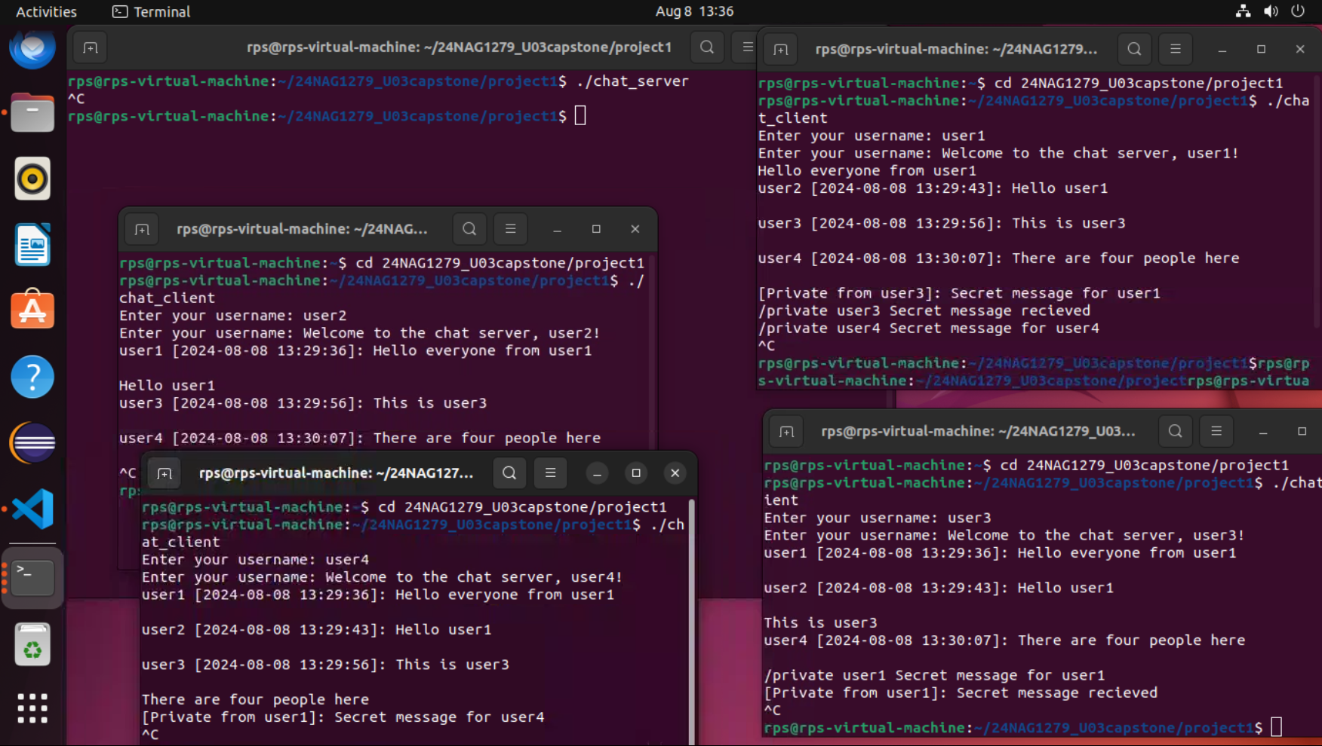
Output
Server
Client#1
Client#2
Client#4
Client#3
Chat Server and 4 Clients

Slide 16
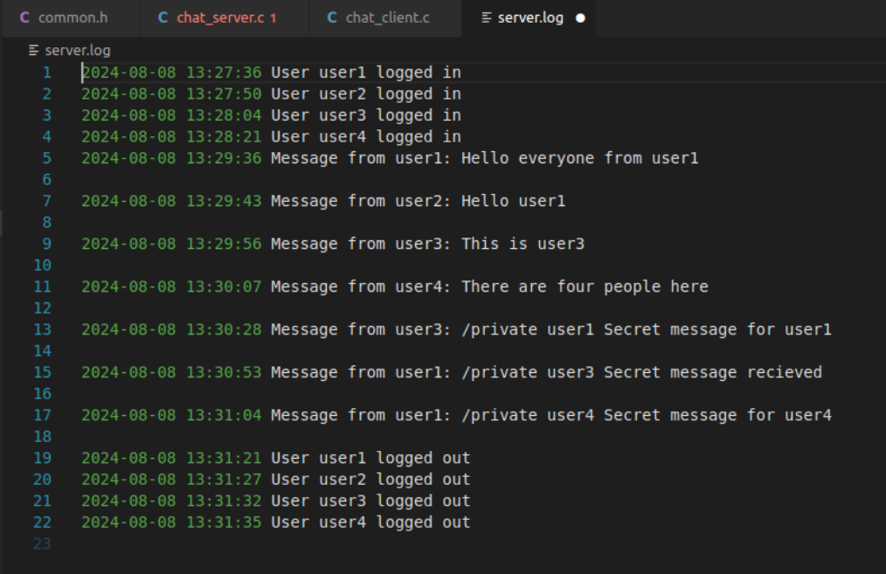
server.log

Slide 17
Future Enhancements
Encrypted communication using SSL/TLS.
Persistent user accounts and password storage.
Graphical user interface (GUI) for the client application.
Group chat functionality.
Message history retrieval.

Slide 18
Conclusion
Developed a multi-threaded chat server and client with enhanced features.
Implemented user authentication, message formatting, and server logging.
The system is scalable and can be extended with additional functionalities.

Slide 19
The End

